Slide 1
Allyship and Accessibility in the Disability Sector Mistakes Made, Lessons Learned and Best Practices
Kirk W. Laughlin, CFRE (he/him) Principal & Lead Nonprofit Strategist of Planet Laughlin
kirk@planetlaughlin.com

Slide 2
Overview
Introduction to disabilities in the workplace and fundraising space
Arguments for accessibility
Allyship & Othering
Personal mistakes and lessons
Applied tools and modalities
Resources for further exploration

Slide 3
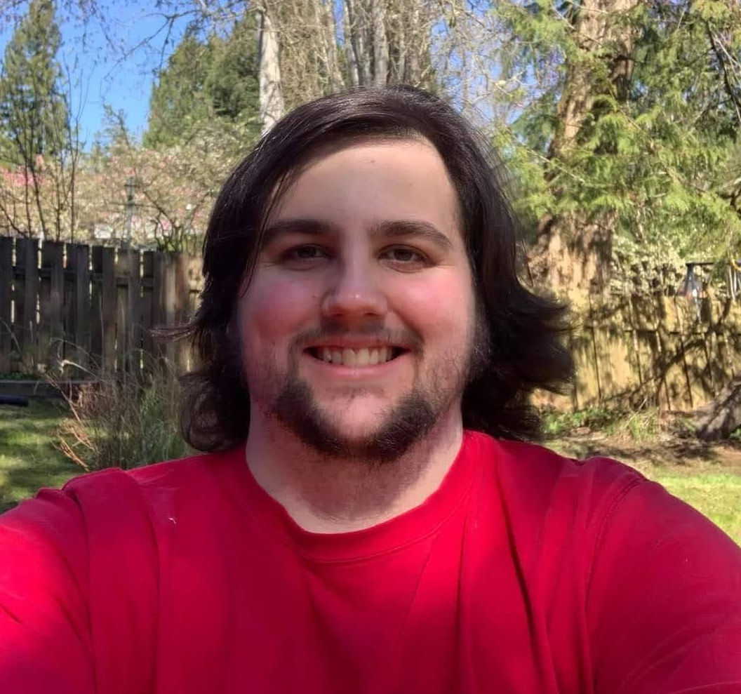
My journey into the disability space

Slide 4
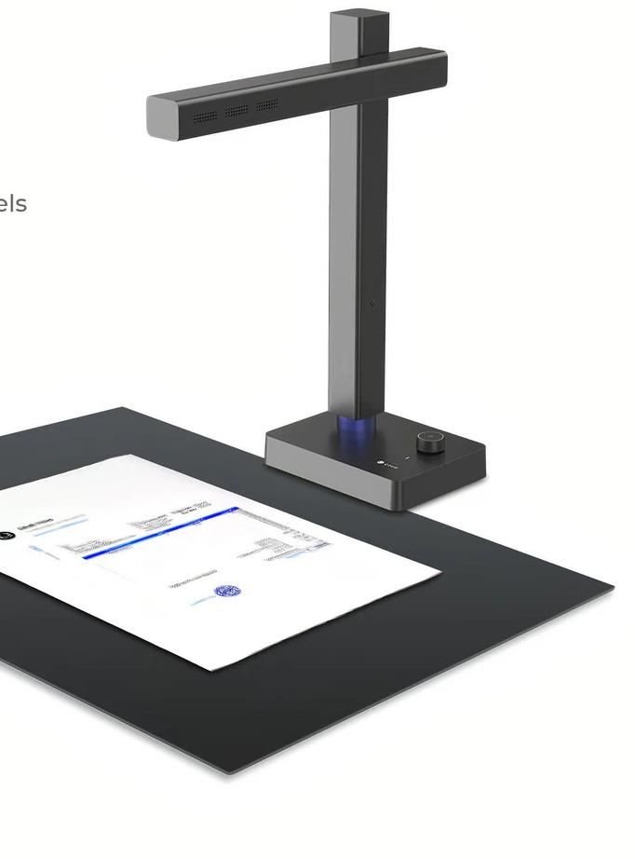
Arguments for Accessibility
A human right
Equity
A responsibility of the nonprofit sector
Noise cancelling headphones
Text scanner for printed text to speech

Slide 5
Brief Overview of Accessibility Movement
“Disability is Diversity” (ARC of King County, WA)
“Accessibility isn’t a strategy or modality - it’s a right” (U. of Washington Haring Center)

Slide 6
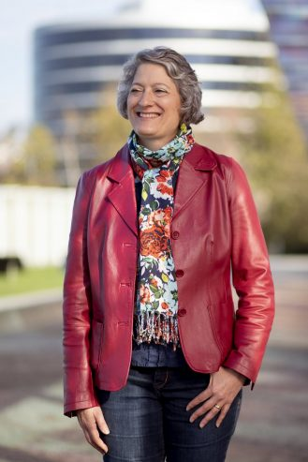
Virtual Panel Member
Elizabeth Ralston, MPH (she/her)
Accessibility Consultant Elizabeth Ralston Consulting, LLC
Photo by Erika Shultz/Seattle Times

Slide 7
Elizabeth Ralston Video

Slide 8
Allyship
An ally is “someone who supports the cause of a marginalized group - and uses their privilege to learn from that group and amplify their cause.” National Association of County Health Officials
“Allyship is a journey, not a destination. You’re constantly learning and you’re constantly evolving.” Elizabeth Ralston, MPH

Slide 9
Advice on Being an Ally
Acknowledge and respect individual experiences and abilities
Learn to actively listen
Observe dynamics of power and privilege
Focus on your impact, not your intent

Slide 10
Advice on Being an Ally
You’re almost certainly going to make mistakes - so use that feedback constructively
Lean into discomfort and consider new perspectives
Avoid pitfalls of your allyship being “one sided” or treating individuals as inferiors

Slide 11
Abelism, “the savior complex” & the Social Model
Abelism and “Putting people on a pedestal”
Infantilizing and othering
Respectful, person-first language
Medical model vs. Social model

Slide 12
Visible vs. Invisible Disabilities
Varying reactions and assumptions
Disability as one point within diversity
Interrogating the workplace & environment

Slide 13
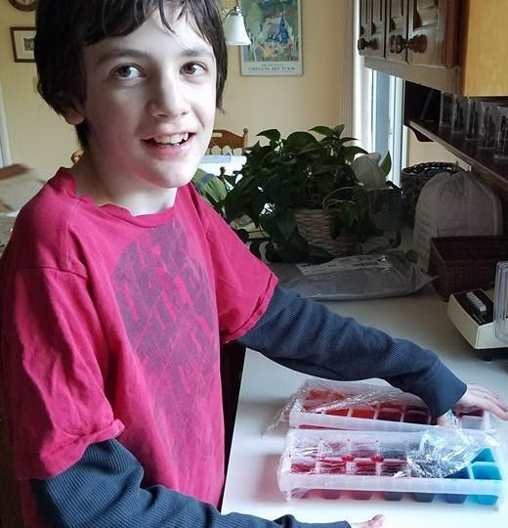
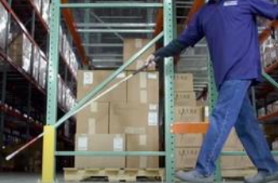
My Own Mistakes and Lessons Learned
Blindness awareness and being a guide
My own neurodiverse students
Workplace advice

Slide 14
Mainstay and SAILS Program at Seattle Central College
Mainstay supports job seekers with disabilities by determining needs of the individual, working with employers and partnering with family members & advocates
SAILS provides resources and guidance for students at Seattle Central College with disabilities to reach their academic goals

Slide 15
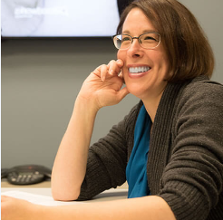
Virtual Panel Member
Rebecca B. Jansson (she/her)
Director of Mainstay Seattle Central College
mainstay-sails.seattlecentral.edu
Rebecca.Jansson@seattlecolleges.edu

Slide 16
Rebecca B. Jansson Video

Slide 17
Applied Advice for the Fundraising Workplace
General accommodations
Events and materials
Materials
Next two panel members are nonprofit leaders and current or former front-line fundraisers with disabilities

Slide 18
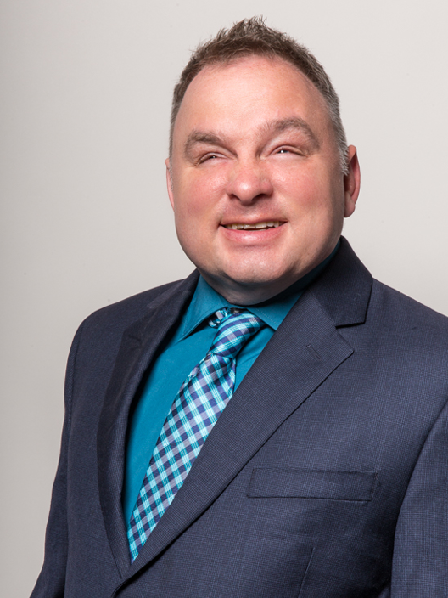
Virtual Panel Member
Shawn Dobbs (he/him)
VP of Marketing & Public Relations The Lighthouse for the Blind, Inc. (Seattle, WA)
https://lhblind.org/
sdobbs@seattlelh.org

Slide 19
Shawn Dobbs Video

Slide 20
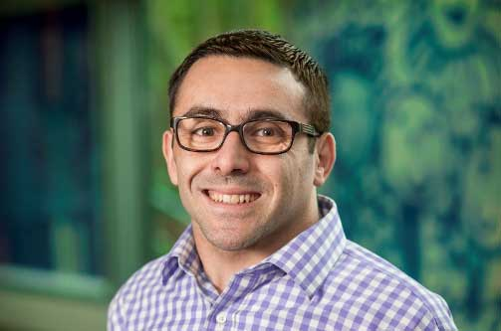
Virtual Panel Member
Cole Hardman (he/him)
Director of Development, Major Gifts Seattle Children’s Foundation
seattlechildrens.org
Cole.Hardman@seattlechildrens.org

Slide 21
Cole Hardman Video

Slide 22
Tools and Best Practices
Applying Universal Design principals to your environment
Start with questions – and continue!
Involve individuals with disabilities in your evaluation
Interrogate your own assumptions

Slide 23
Tools and Best Practices - Examples
Wayfinders
Braille displays
Large Print
Visual contrasts in the environment
Graphics, web design and alt text in images
Taking the time

Slide 24
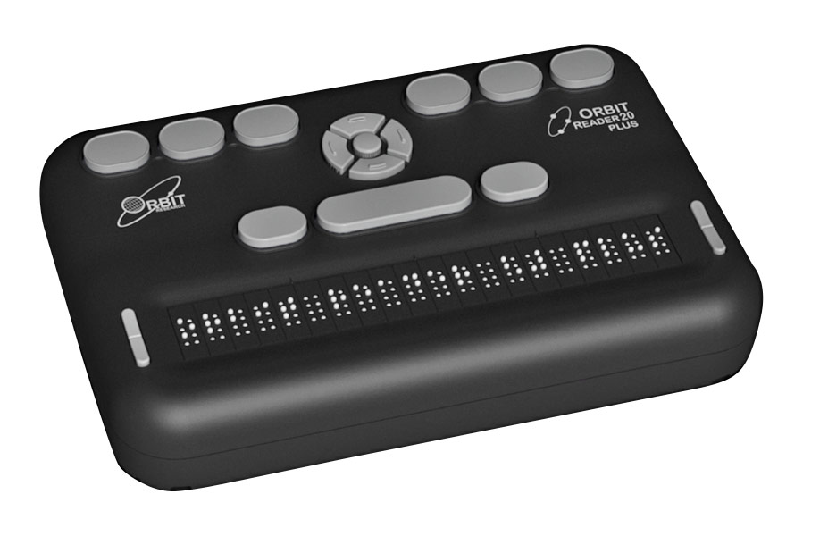
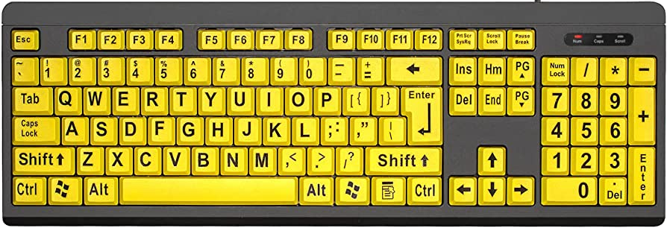
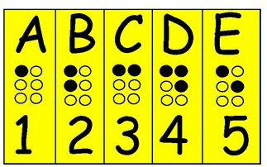
Tools and Best Practices - Examples
Refreshable Braille Display
High Contrast Flash Card
High contrast keyboard

Slide 25
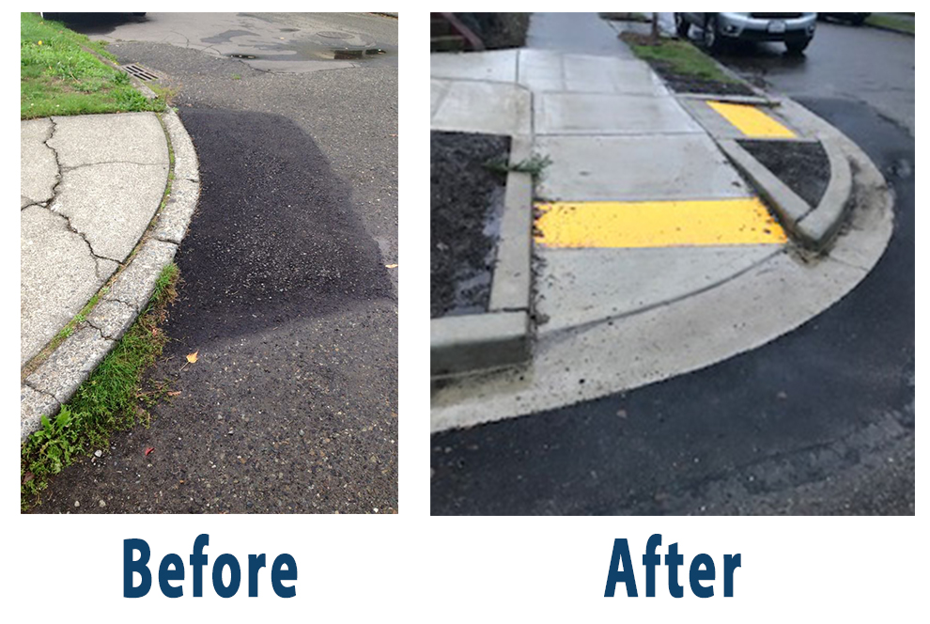
Tools and Best Practices - Examples
Way Finding Strips
Curb Cut

Slide 26
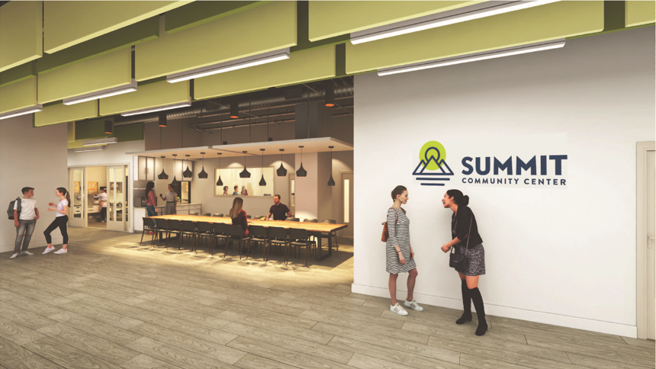
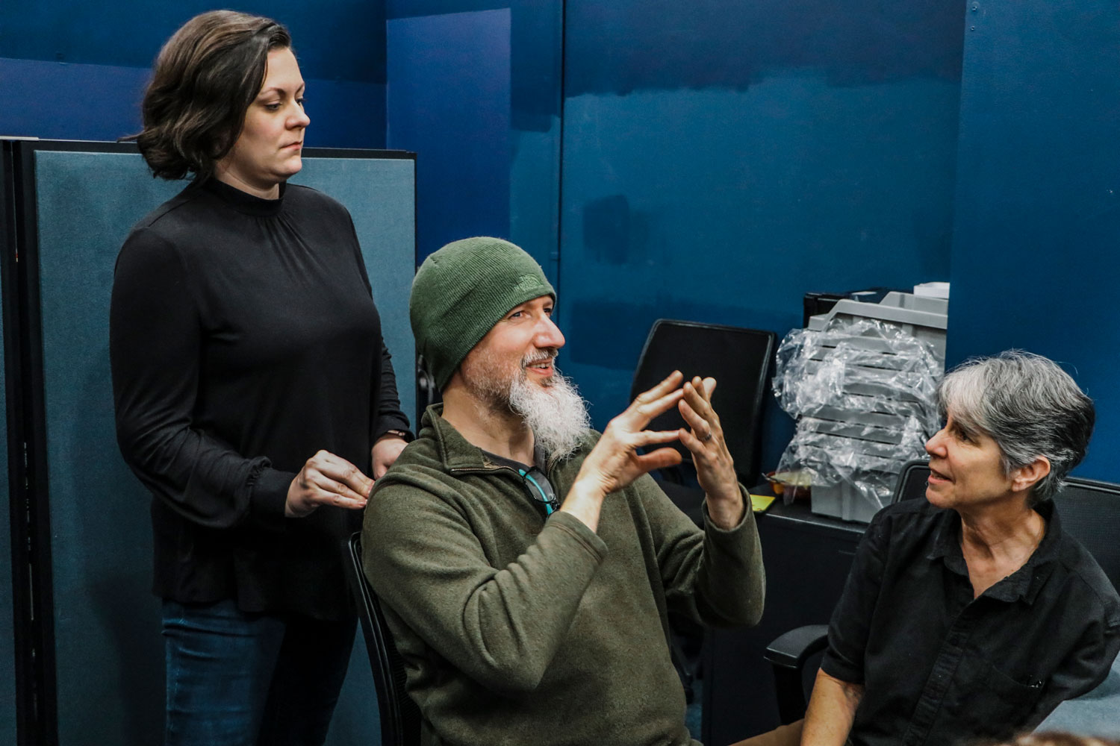
Tools and Best Practices - Examples
Quiet Spaces
High-Contrast Walls and Clothing

Slide 27
Tools and Best Practices
Physical design for those with “invisible disabilities”/neurodiversity
Sound/scent sensitivity
Guiding notes
Access to remote work
Evaluation of your own assumptions

Slide 28
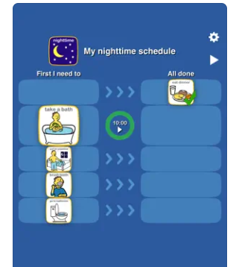
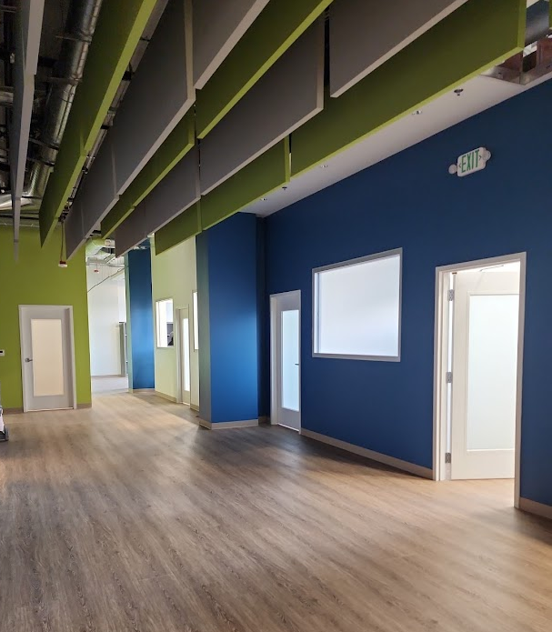
Tools and Best Practices - Examples
Visual Calendar/Planning App
Noise Cancelling Headphones
Sound Absorbing Panels

Slide 29
Tools and Best Practices
Research local and online resources
Actively involve individuals with disabilities in evaluating
Make this aspect of equity integral to your organization’s culture, policies and practices.
“Universally design” your organization’s culture
Be open and accepting to feedback and criticism

Slide 30
Resources
Elizabeth Ralston Consulting Resources
Examples of Training Topics from Elizabeth Ralston
Disability:IN.org
Respectability.org
Rooted in Rights
Job Accommodation Network - Resources for Employers Disability Inclusion Network (WA) - Resources for Employers

Slide 31
Resources
The Arc of King County – Disability is Diversity Training
The Arc of King County: Supported Employment – Strategies & Resources for Assisting People with Disabilities in Finding Employment (video)
The Arc of King County – Abelisim & Disability Justice
The Lighthouse for the Blind, Inc – Low Cost Ways to Make Your Workplace Accessible
Academy for Precision Learning
Summit Community Center

Slide 32
Contact Info for Panel Members
Elizabeth Ralston, MPH (she/her)
Accessibility Consultant
Elizabeth Ralston Consulting, LLC - elizabethralston.com
206.229.4168
elizabeth@elizabethralston.com
LinkedIn - linkedin.com/in/elizabeth-ralston-14505543/
Rebecca B. Jansson (she/her)
Director of Mainstay, Seattle Central College
206.934.5429 Rebecca.Jansson@seattlecolleges.edu
mainstay-sails.seattlecentral.edu

Slide 33
Contact Info for Panel Members
Shawn Dobbs
VP of Marketing & Public Relations
The Lighthouse for the Blind, Inc.
sdobbs@lhblind.org
lhblind.org
Cole Hardman
Director of Development, Major Gifts
Seattle Children's Foundation
206.987.8119
cole.hardman@seattlechildrens.org
seattlechildrens.org

Slide 34
Allyship and Accessibility in the Disability Sector Mistakes Made, Lessons Learned and Best Practices
Kirk W. Laughlin, CFRE (he/him) Principal & Lead Nonprofit Strategist of Planet Laughlin
LinkedIn - company/planetlaughlin
LinkedIn – in/kirkseattle
206-289-0612 kirk@planetlaughlin.com

